Slide 1
Accelerating Independent Component Analysis on GPU
Cognitive and Computational Neuroscience Lab
School of Life Sciences, Fudan University
2018-09-21
2022-04-23 updated

Slide 2
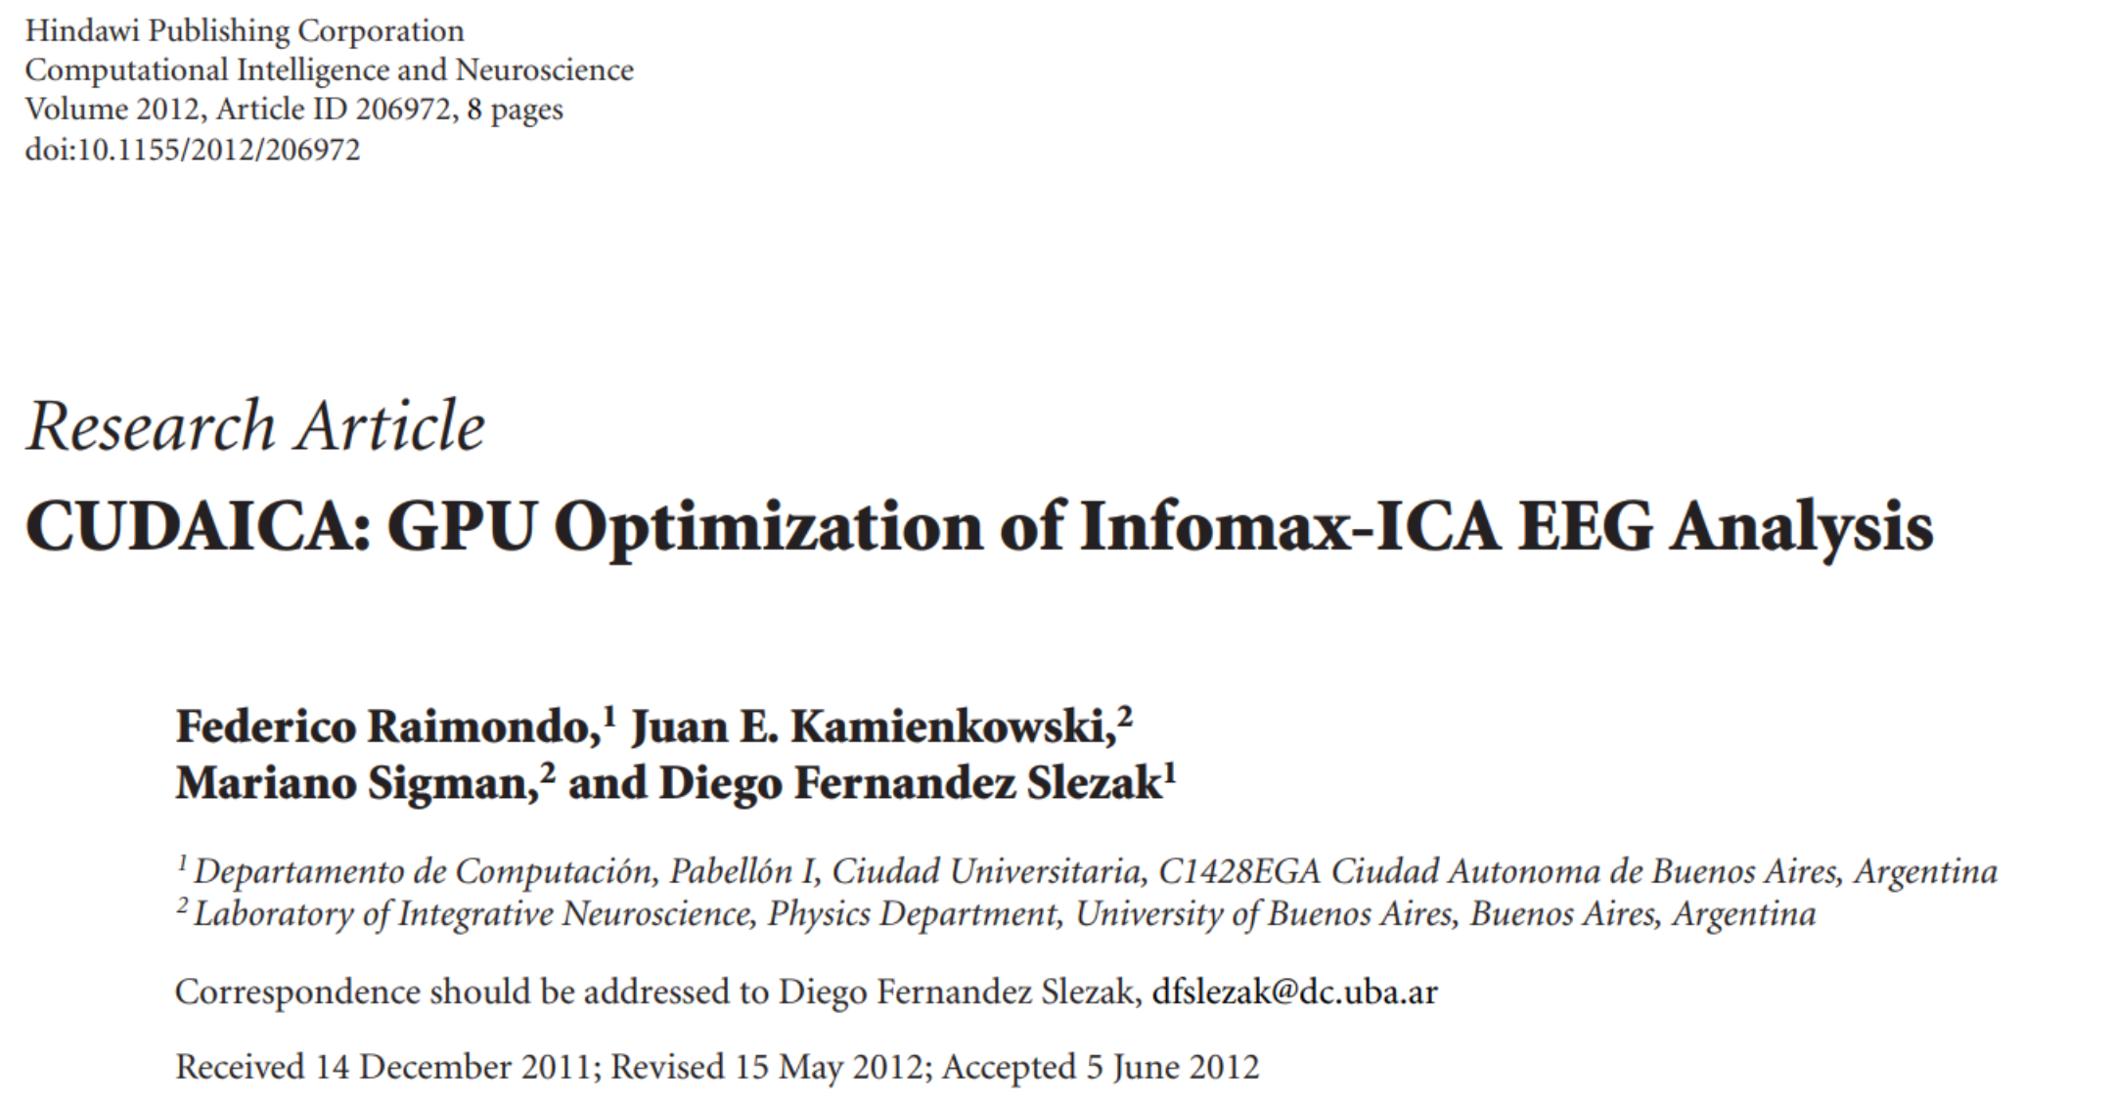
ICA Running on GPU

Slide 3
What have been improved now
Can be compiled and run under Windows.
3-4 times faster than original CUDAICA, 8~12 times faster than RUNICA.
Improved numerical accuracy.

Slide 4
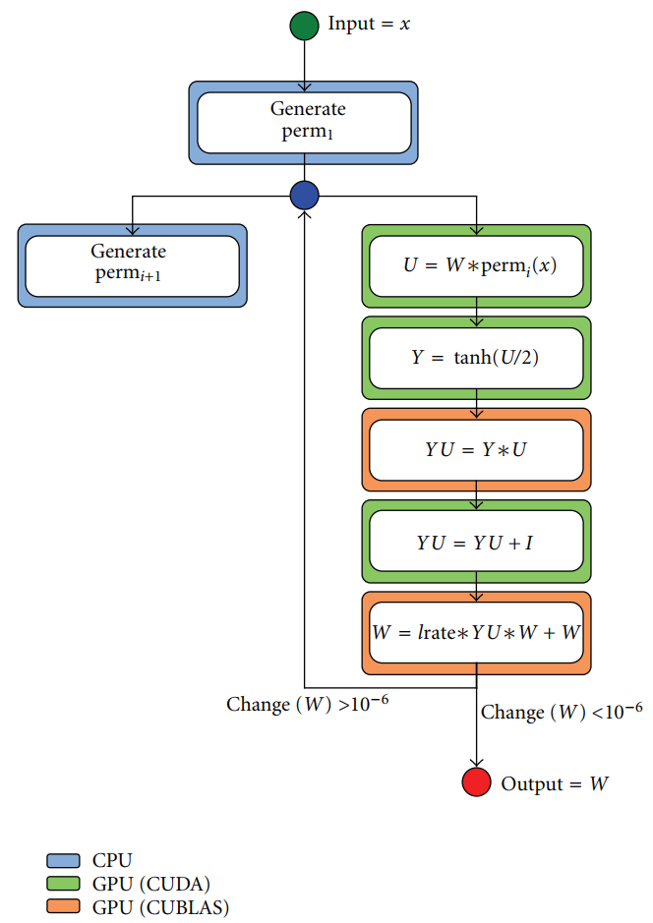
Increase Calculation Speed
Original:
Current:
(CUDA)
(CUDA)

Slide 5
Calculation Speed
Environment:
CPU: Intel Core i7 7700HQ
GPU: NVIDIA GeForce GTX 1050Ti (4GB)
Matlab R2017b Update 7
NVIDIA CUDA 9.2
Intel Parallel Studio XE 2018 update 3
Results
Data 1: 31*1075359 samples
RUNICA: 2038.73 seconds (33.98 minutes) / 404 steps = 5.0464 seconds/step
CUDAICA: 145 seconds (2.25 minutes) / 365 steps = 0.3973 seconds/step
Data 2: 63*1867695 samples
RUNICA : 4941 seconds (82.35 minutes) / 438 steps = 11.2808 seconds/step
CUDAICA: 461 seconds (7.68 minutes) / 398 steps = 1.1582 seconds/step
Data 3: 63*697500 samples
RUNICA : 1676.19 seconds (27.94 minutes) / 397 steps = 4.2221 seconds/step
CUDAICA: 194 seconds (3.23 minutes) / 372 steps = 0.5215 seconds/step

Slide 6
Numerical Accuracy
For small datasets
Same random number generator + same block separation method →Same decomposition results between RUNICA and CUDAICA.
*PCA: you may get results with same absolute values but opposite signs.
For large datasets
Decomposition results will be similar but different.
Different machine implementation.
Non-associativity of numerical calculation ((a+b)+c ≠ a+(b+c)).
Different precision on CPU and GPU.

Slide 7
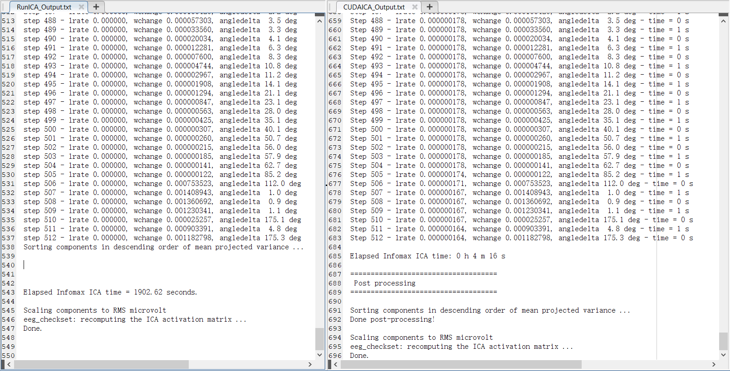
Numerical Accuracy – Small Dataset
64*697500 samples, no PCA, fix random number seed

Slide 8
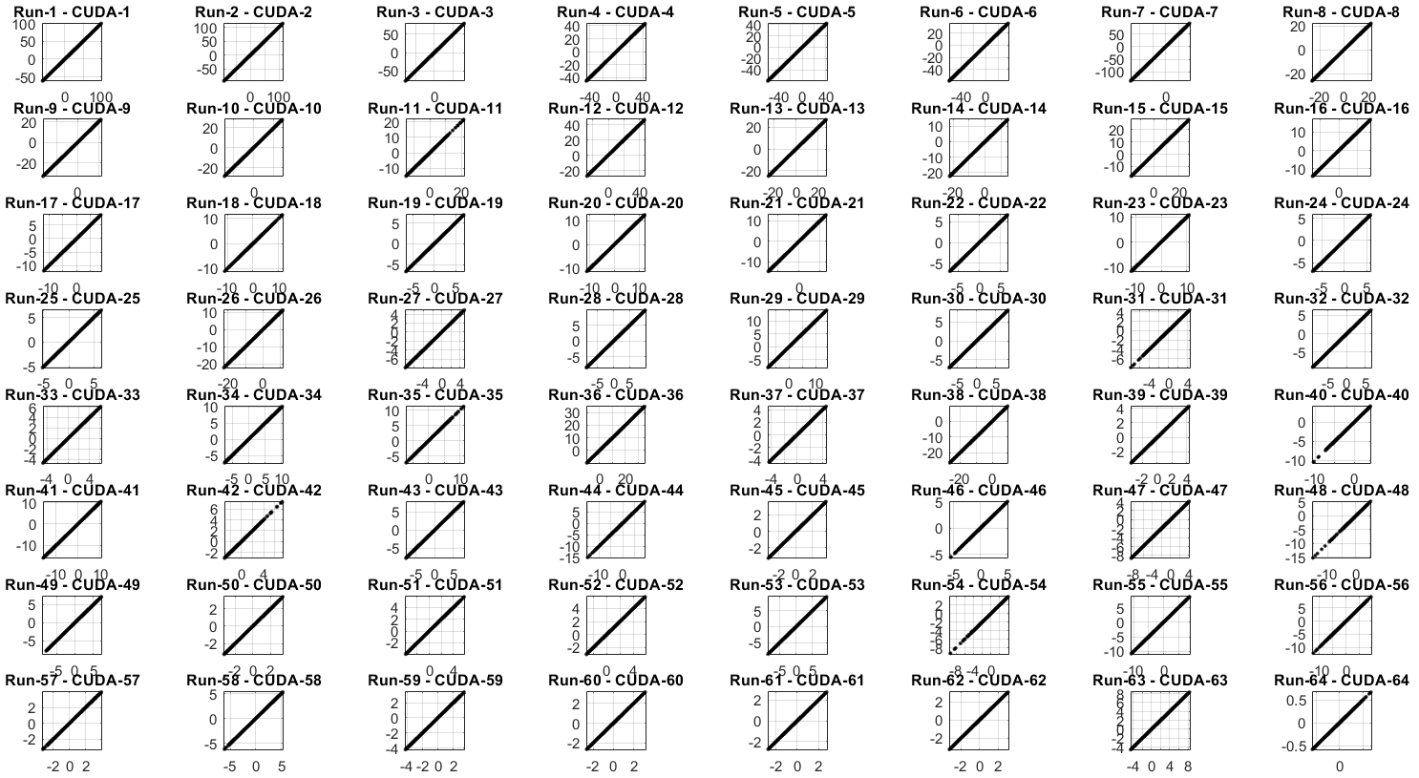
Numerical Accuracy – Small Dataset
64*697500 samples, no PCA, fix random number seed
Notes:
Notes: This figure (and similar figures below) shows the comparison of IC activations by CUDAICA and RunICA. Each subplot plots the IC activations by RunICA versus activations by CUDAICA point-by-point. If the activations are the same, the dots will lie on one of the two diagonal lines (ICA is not affected by sign-flip of the weights and activations).

Slide 9
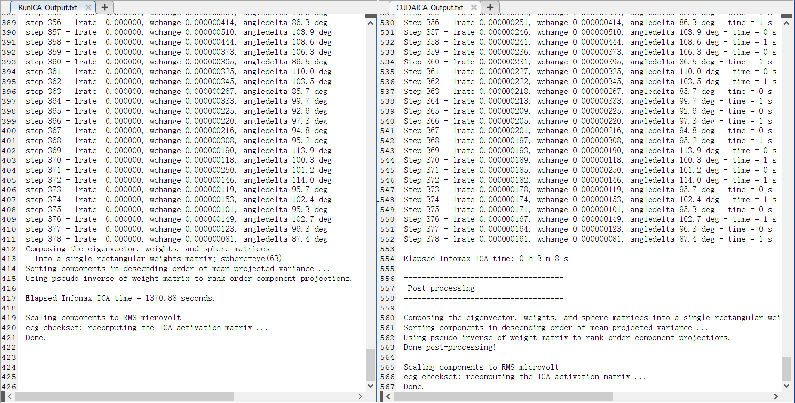
Numerical Accuracy – Small Dataset
64*697500 samples, PCA to 63 channels, fix random number seed

Slide 10
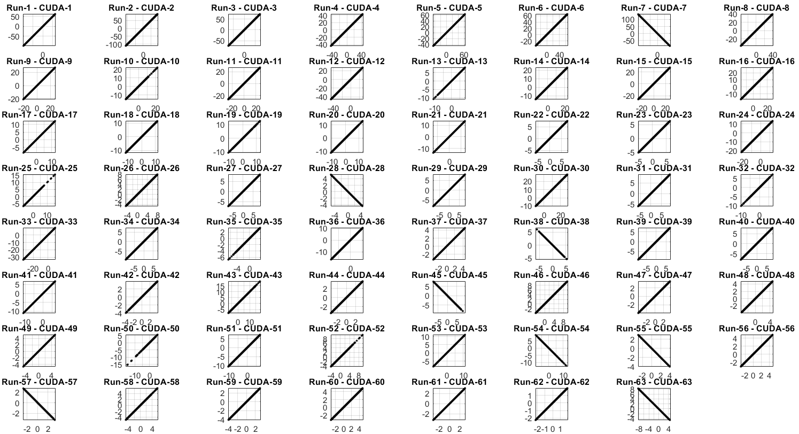
Numerical Accuracy – Small Dataset
64*697500 samples, PCA to 63 channels, fix random number seed

Slide 11
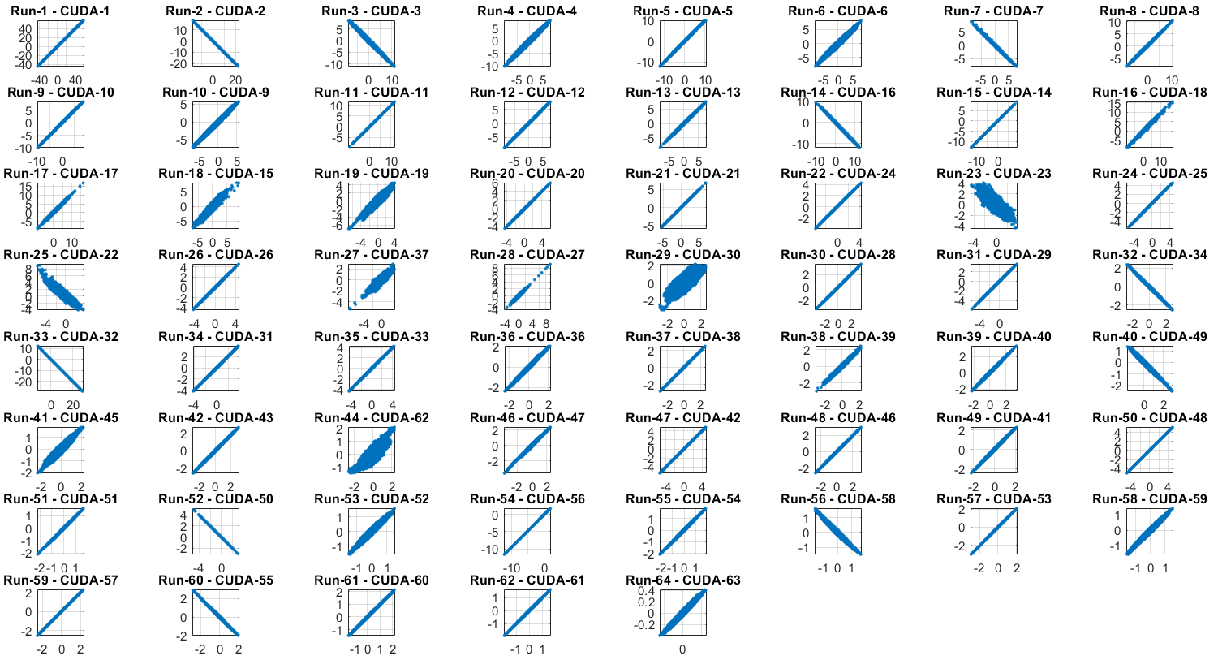
Numerical Accuracy – Large Dataset
64*1178845 samples, no PCA, fix random number seed

Slide 12
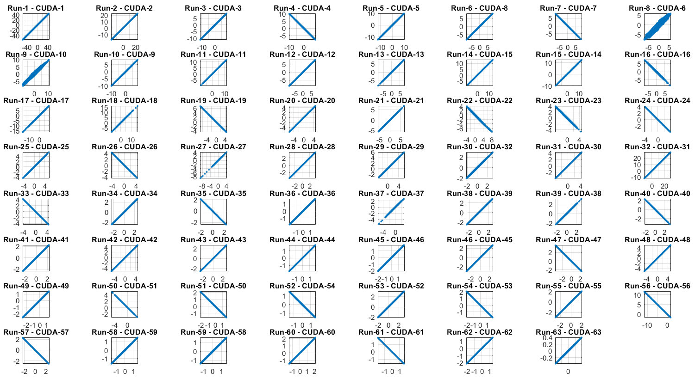
Numerical Accuracy – Large Dataset
64*1178845 samples, PCA to 63 channels, fix random number seed

Slide 13
Installation Requirements
NVIDIA GPU
Recommend: > GeForce GTX 960 or GTX 1050Ti, or recent TITAN, Tesla and Quadro series.
Enough GPU memory (recommend > 4GB, depends on data size).
Older NVIDIA GPU may be okay but slow.
Software dependencies
NVIDIA CUDA: https://developer.nvidia.com/cuda-downloads.
If you directly use the pre-compiled exe file, only CUDA runtime and the latest driver are needed.
Intel MKL in Intel Parallel Studio XE (latest 2020 update 4, deprecated since year 2021):
https://software.intel.com/en-us/parallel-studio-xe/choose-download/student-windows
or, Intel MKL in the oneAPI base toolkit (current latest 2022):
https://www.intel.com/content/www/us/en/developer/tools/oneapi/onemkl-download.html
EEGLAB
Add MKL library directory to environment variable path.
Intel MKL 2020 default location: “C:\Program Files (x86)\IntelSWTools\compilers_and_libraries\windows\redist\intel64\mkl”
Intel OneAPI 2022 default location: “C:\Program Files (x86)\Intel\oneAPI\mkl\latest\redist\intel64”
No space character (“ ”) in the EEGLAB plugin’s directory.

Slide 14
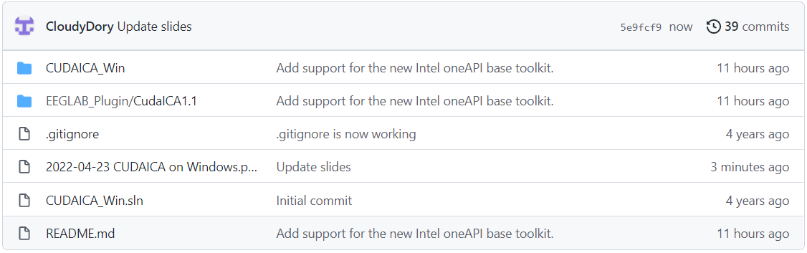
Installation
Source code: https://github.com/CloudyDory/cudaica_win
Download EEGLAB_plugin/CudaICA1.1 folder (compiled binary included), follow readme inside.
(For developers, not normal users) Compile binary under Windows
NVIDIA CUDA: https://developer.nvidia.com/cuda-downloads.
Install CUDA runtime, CUDA development and the latest drivers.
Intel MKL in Intel oneAPI base toolkit (only the MKL is needed, other components are not required)
https://www.intel.com/content/www/us/en/developer/tools/oneapi/onemkl-download.html.
Microsoft Visual Studio supported by both above (the latest version may not be supported).
(https://visualstudio.microsoft.com/download)

Slide 15
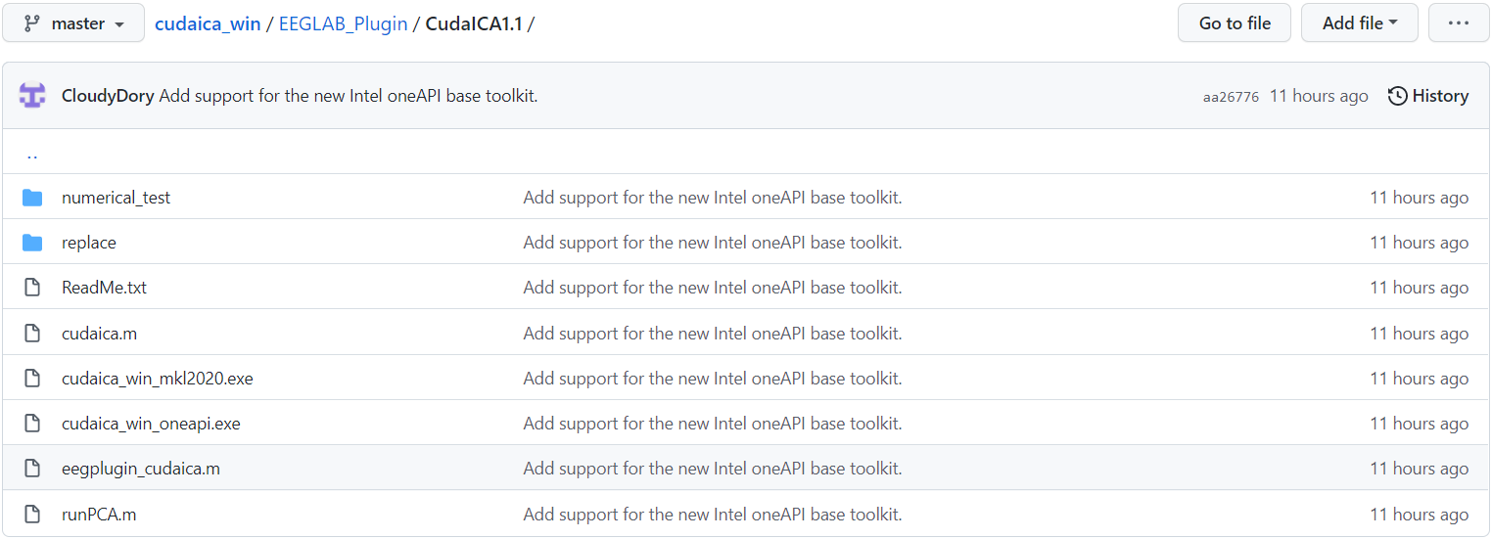
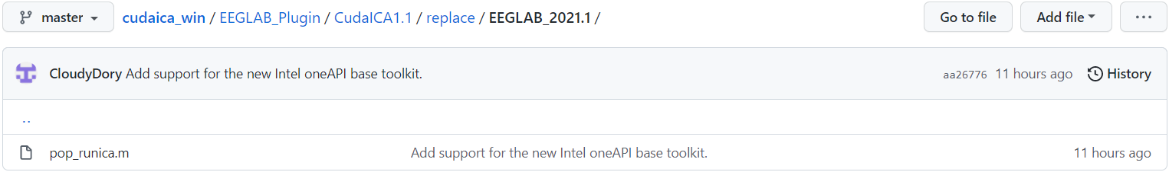
Installation
These four files actually run ICA and PCA.
This file is needed to call cudaica from GUI or command line. They are modified from the original one in EEGLAB.
You should override EEGLAB’s default functions with them.

Slide 16
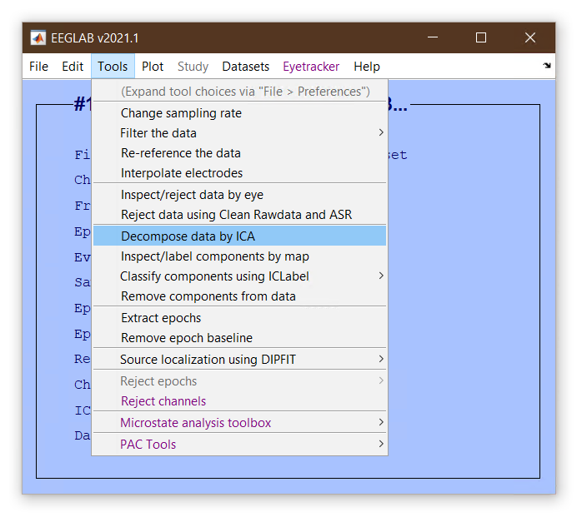
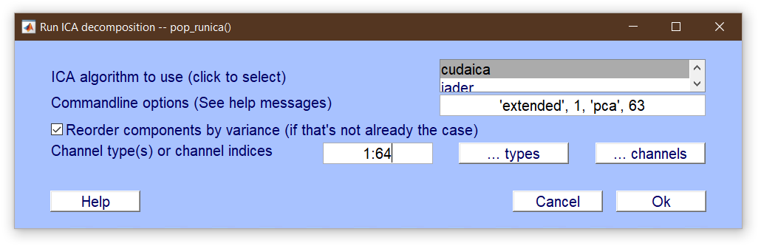
Usage
Both GUI and command line usage are possible.
[EEG, command] = pop_runica(EEG, 'icatype','cudaica', 'options',{'extended',1,'pca',63}, 'chanind', 1:64);

Slide 17
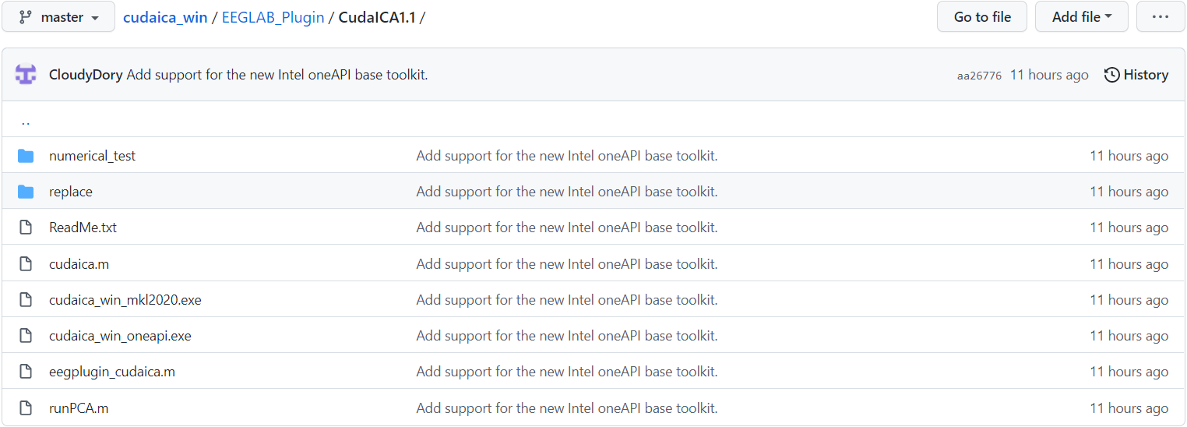
Verify numerical accuracy
You can verify numerical accuracy before using CUDAICA on experiment data.

Slide 18
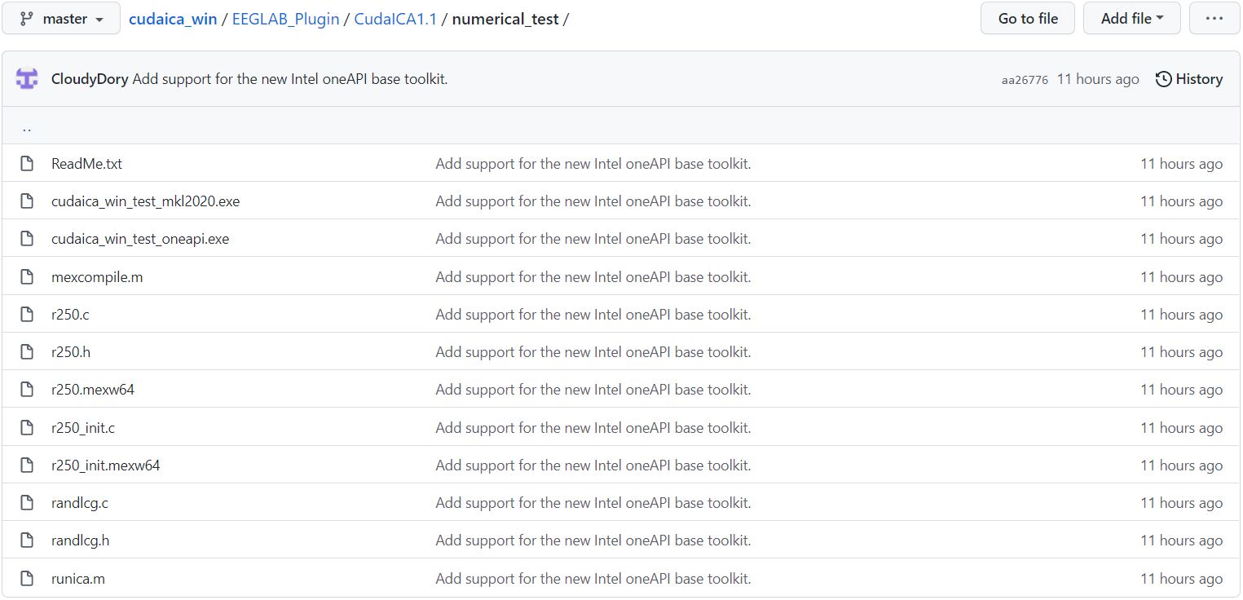
Verify numerical accuracy
Modified cudaica that use fixed random number seed.
If the mexw64 file fails, recompile them.
Random number generator used by “runica.m”. This is the same as the one used in cudaica binary.
Modified EEGLAB’s runica algorithm, use the same random number seed and block separation method as in “cudaica_win_test_mkl2020.exe” and “cudaica_win_test_oneapi.exe”.

Slide 19
Known Issues and Limitations
Matlab command output window may stuck when running CUDAICA, but this does not affect the speed and accuracy of calculation.
We have only tested the code on Windows 10.
Previous versions of CUDAICA works on Windows 7, but new versions are no longer tested.
Windows 11 has never been tested.
You may not be able to see rising GPU usage in Windows task manager, but this does not affect the calculation.
There should be no space character (“ ”) in the path of “cudaica.exe” and Matlab’s current folder. Otherwise “cudaica.exe” cannot read the “.sc” files generated by “cudaica.m”.
“cudaica.m” automatically detects whether the Windows system path contains “IntelSWTools” or “oneAPI”, and selects the correct cudaica binary exe file to use. Please make sure your Intel MKL installation path contains one of the above two patterns.

